Slide 1

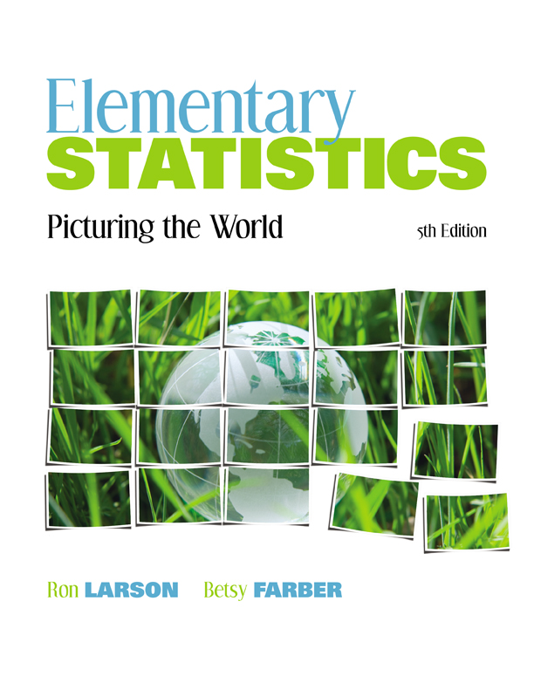

Chapter
2
Descriptive Statistics
© 2012 Pearson Education, Inc.
All rights reserved.
<number> of 149

Slide 2
Chapter Outline
2.4 Measures of Variation
© 2012 Pearson Education, Inc. All rights reserved.
<number> of 149

Slide 3
Section 2.4
Measures of Variation
© 2012 Pearson Education, Inc. All rights reserved.
<number> of 149

Slide 4
Section 2.4 Objectives
Determine the range of a data set
Determine the variance and standard deviation of a population and of a sample
Use the Empirical Rule and Chebychev’s Theorem to interpret standard deviation
Approximate the sample standard deviation for grouped data
© 2012 Pearson Education, Inc. All rights reserved.
<number> of 149

Slide 5
Range
Range
The difference between the maximum and minimum data entries in the set.
The data must be quantitative.
Range = (Max. data entry) – (Min. data entry)
© 2012 Pearson Education, Inc. All rights reserved.
<number> of 149

Slide 6
Example: Finding the Range
A corporation hired 10 graduates. The starting salaries for each graduate are shown. Find the range of the starting salaries.
Starting salaries (1000s of dollars)
41 38 39 45 47 41 44 41 37 42
© 2012 Pearson Education, Inc. All rights reserved.
<number> of 149

Slide 7
Solution: Finding the Range
Ordering the data helps to find the least and greatest salaries.
  37 38 39 41 41 41 42 44 45 47
Range = (Max. salary) – (Min. salary)
= 47 – 37 = 10
The range of starting salaries is 10 or $10,000.
minimum
maximum
© 2012 Pearson Education, Inc. All rights reserved.
<number> of 149

Slide 8

Deviation, Variance, and Standard Deviation
Deviation
The difference between the data entry, x, and the mean of the data set.
Population data set:
  Deviation of x = x – μ
Sample data set:
  Deviation of
© 2012 Pearson Education, Inc. All rights reserved.
<number> of 149

Slide 9
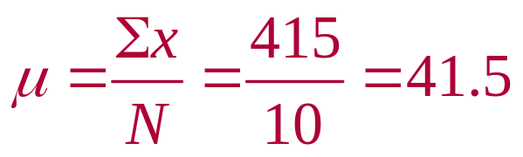
Example: Finding the Deviation
A corporation hired 10 graduates. The starting salaries for each graduate are shown. Find the deviation of the starting salaries.
Starting salaries (1000s of dollars)
41 38 39 45 47 41 44 41 37 42
Solution:
First determine the mean starting salary.
© 2012 Pearson Education, Inc. All rights reserved.
<number> of 149

Slide 10
Solution: Finding the Deviation
Determine the deviation for each data entry.
Salary ($1000s), x | Deviation ($1000s) x – μ
41 | 41 – 41.5 = –0.5
38 | 38 – 41.5 = –3.5
39 | 39 – 41.5 = –2.5
45 | 45 – 41.5 = 3.5
47 | 47 – 41.5 = 5.5
41 | 41 – 41.5 = –0.5
44 | 44 – 41.5 = 2.5
41 | 41 – 41.5 = –0.5
37 | 37 – 41.5 = –4.5
42 | 42 – 41.5 = 0.5
Σx = 415
Σ(x – μ) = 0
© 2012 Pearson Education, Inc. All rights reserved.
<number> of 149

Slide 11
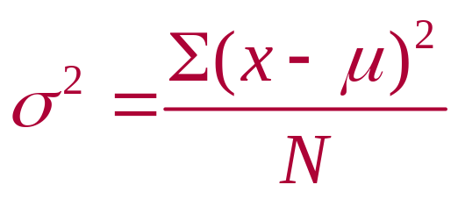
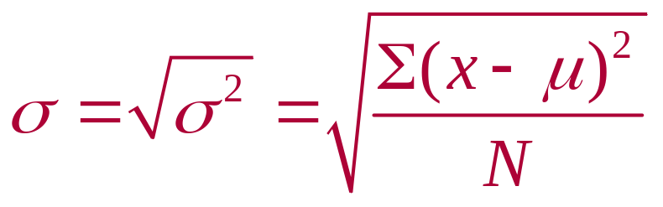
Deviation, Variance, and Standard Deviation
Population Variance
Population Standard Deviation
Sum of squares, SS_{x}
© 2012 Pearson Education, Inc. All rights reserved.
<number> of 149

Slide 12
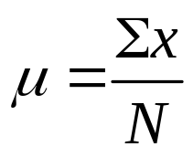
Finding the Population Variance & Standard Deviation
In Words In Symbols
Find the mean of the population data set.
Find the deviation of each entry.
Square each deviation.
Add to get the sum of squares.
x – μ
(x – μ)²
SS_{x} = Σ(x – μ)²
© 2012 Pearson Education, Inc. All rights reserved.
<number> of 149

Slide 13
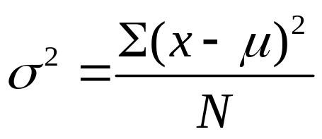
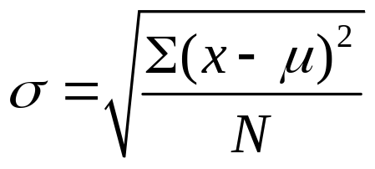
Finding the Population Variance & Standard Deviation
In Words In Symbols
Divide by N to get the population variance.
Find the square root of the variance to get the population standard deviation.
© 2012 Pearson Education, Inc. All rights reserved.
<number> of 149

Slide 14
Example: Finding the Population Standard Deviation
A corporation hired 10 graduates. The starting salaries for each graduate are shown. Find the population variance and standard deviation of the starting salaries.
Starting salaries (1000s of dollars)
41 38 39 45 47 41 44 41 37 42
Recall μ = 41.5.
© 2012 Pearson Education, Inc. All rights reserved.
<number> of 149

Slide 15
Solution: Finding the Population Standard Deviation
Determine SS_{x}
N = 10
Salary, x | Deviation: x – μ | Squares: (x – μ)²
41 | 41 – 41.5 = –0.5 | (–0.5)² = 0.25
38 | 38 – 41.5 = –3.5 | (–3.5)² = 12.25
39 | 39 – 41.5 = –2.5 | (–2.5)² = 6.25
45 | 45 – 41.5 = 3.5 | (3.5)² = 12.25
47 | 47 – 41.5 = 5.5 | (5.5)² = 30.25
41 | 41 – 41.5 = –0.5 | (–0.5)² = 0.25
44 | 44 – 41.5 = 2.5 | (2.5)² = 6.25
41 | 41 – 41.5 = –0.5 | (–0.5)² = 0.25
37 | 37 – 41.5 = –4.5 | (–4.5)² = 20.25
42 | 42 – 41.5 = 0.5 | (0.5)² = 0.25
Σ(x – μ) = 0
SS_{x} = 88.5
© 2012 Pearson Education, Inc. All rights reserved.
<number> of 149

Slide 16
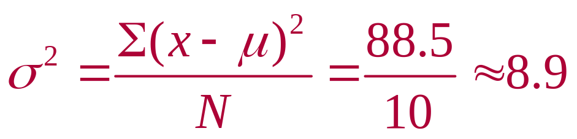
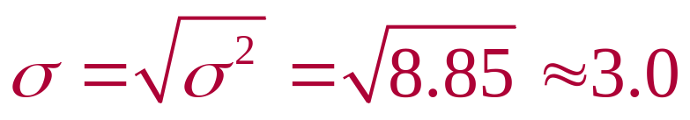
Solution: Finding the Population Standard Deviation
Population Variance
Population Standard Deviation
The population standard deviation is about 3.0, or $3000.
© 2012 Pearson Education, Inc. All rights reserved.
<number> of 149

Slide 17
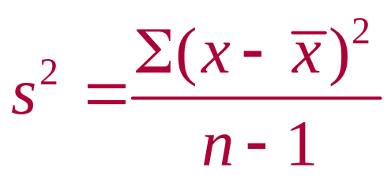
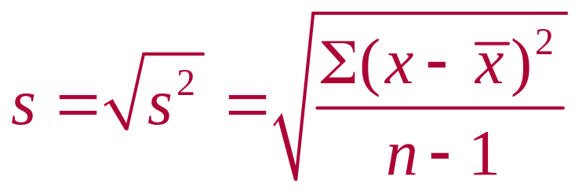
Deviation, Variance, and Standard Deviation
Sample Variance
Sample Standard Deviation
© 2012 Pearson Education, Inc. All rights reserved.
<number> of 149

Slide 18
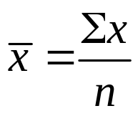

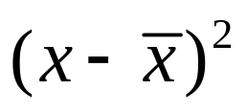
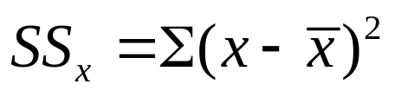
Finding the Sample Variance & Standard Deviation
In Words In Symbols
Find the mean of the sample data set.
Find the deviation of each entry.
Square each deviation.
Add to get the sum of squares.
© 2012 Pearson Education, Inc. All rights reserved.
<number> of 149

Slide 19
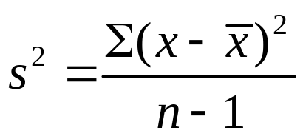
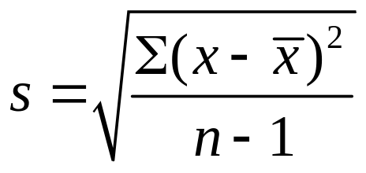
Finding the Sample Variance & Standard Deviation
In Words In Symbols
Divide by n – 1 to get the sample variance.
Find the square root of the variance to get the sample standard deviation.
© 2012 Pearson Education, Inc. All rights reserved.
<number> of 149

Slide 20
Example: Finding the Sample Standard Deviation
The starting salaries are for the Chicago branches of a corporation. The corporation has several other branches, and you plan to use the starting salaries of the Chicago branches to estimate the starting salaries for the larger population. Find the sample standard deviation of the starting salaries.
Starting salaries (1000s of dollars)
41 38 39 45 47 41 44 41 37 42
© 2012 Pearson Education, Inc. All rights reserved.
<number> of 149

Slide 21
Solution: Finding the Sample Standard Deviation
Determine SS_{x}
n = 10
Salary, x | Deviation: x – μ | Squares: (x – μ)²
41 | 41 – 41.5 = –0.5 | (–0.5)² = 0.25
38 | 38 – 41.5 = –3.5 | (–3.5)² = 12.25
39 | 39 – 41.5 = –2.5 | (–2.5)² = 6.25
45 | 45 – 41.5 = 3.5 | (3.5)² = 12.25
47 | 47 – 41.5 = 5.5 | (5.5)² = 30.25
41 | 41 – 41.5 = –0.5 | (–0.5)² = 0.25
44 | 44 – 41.5 = 2.5 | (2.5)² = 6.25
41 | 41 – 41.5 = –0.5 | (–0.5)² = 0.25
37 | 37 – 41.5 = –4.5 | (–4.5)² = 20.25
42 | 42 – 41.5 = 0.5 | (0.5)² = 0.25
Σ(x – μ) = 0
SS_{x} = 88.5
© 2012 Pearson Education, Inc. All rights reserved.
<number> of 149

Slide 22
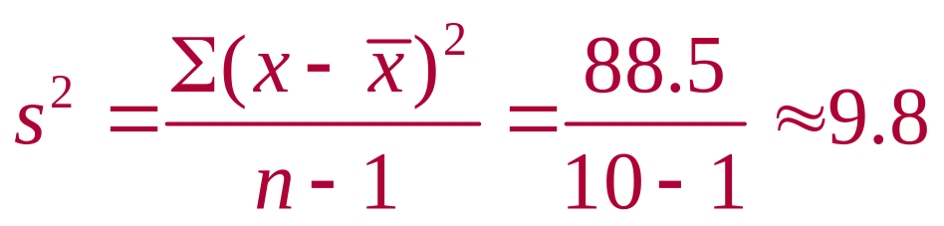
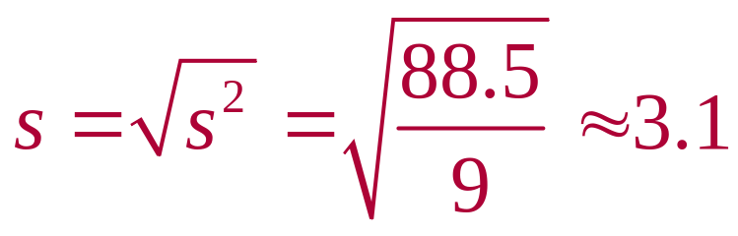
Solution: Finding the Sample Standard Deviation
Sample Variance
Sample Standard Deviation
The sample standard deviation is about 3.1, or $3100.
© 2012 Pearson Education, Inc. All rights reserved.
<number> of 149

Slide 23
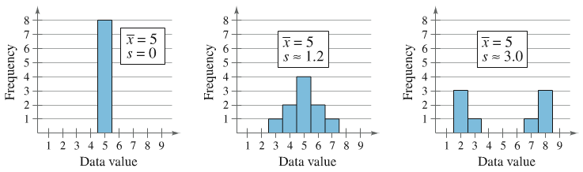
Interpreting Standard Deviation
Standard deviation is a measure of the typical amount an entry deviates from the mean.
The more the entries are spread out, the greater the standard deviation.
© 2012 Pearson Education, Inc. All rights reserved.
<number> of 149

Slide 24
Interpreting Standard Deviation: Empirical Rule (68 – 95 – 99.7 Rule)
For data with a (symmetric) bell-shaped distribution, the standard deviation has the following characteristics:
About 68% of the data lie within one standard deviation of the mean.
About 95% of the data lie within two standard deviations of the mean.
About 99.7% of the data lie within three standard deviations of the mean.
© 2012 Pearson Education, Inc. All rights reserved.
<number> of 149

Slide 25
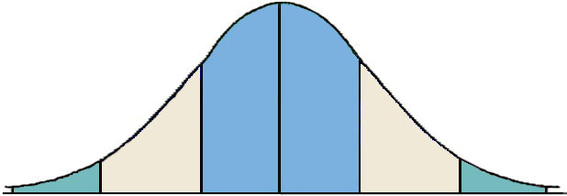







Interpreting Standard Deviation: Empirical Rule (68 – 95 – 99.7 Rule)
99.7% within 3 standard deviations
95% within 2 standard deviations
68% within 1 standard deviation
34%
34%
2.35%
2.35%
13.5%
13.5%
© 2012 Pearson Education, Inc. All rights reserved.
<number> of 149

Slide 26
Example: Using the Empirical Rule
In a survey conducted by the National Center for Health Statistics, the sample mean height of women in the United States (ages 20-29) was 64.3 inches, with a sample standard deviation of 2.62 inches. Estimate the percent of the women whose heights are between 59.06 inches and 64.3 inches.
© 2012 Pearson Education, Inc. All rights reserved.
<number> of 149

Slide 27
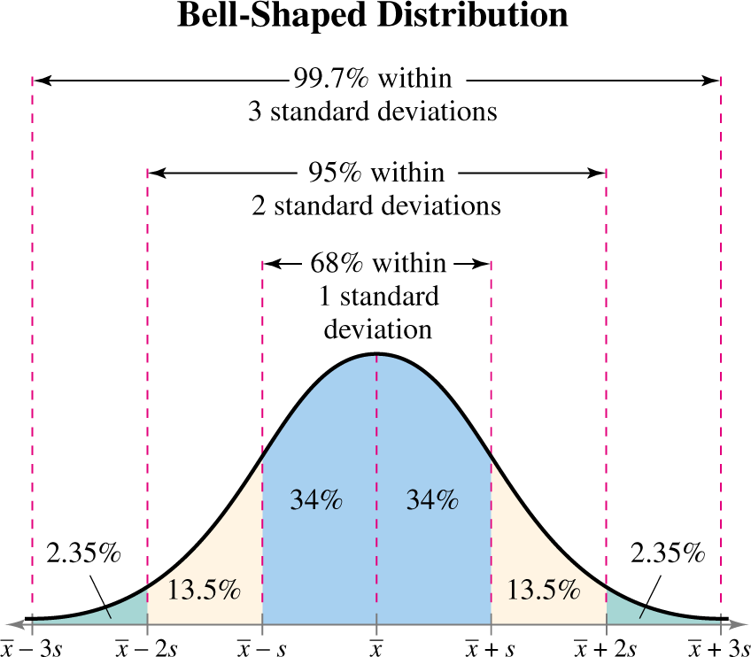
Solution: Using the Empirical Rule
Because the distribution is bell-shaped, you can use the Empirical Rule.
34% + 13.5% = 47.5% of women are between 59.06 and 64.3 inches tall.
© 2012 Pearson Education, Inc. All rights reserved.
<number> of 149

Slide 28
Section 2.4 Summary
Determined the range of a data set
Determined the variance and standard deviation of a population and of a sample
Used the Empirical Rule and Chebychev’s Theorem to interpret standard deviation
Approximated the sample standard deviation for grouped data
© 2012 Pearson Education, Inc. All rights reserved.
<number> of 149

